Slide 1

LetsGo App
UX2 Case Study | Brandon Norton
March 2023

Slide 2
Overview
Discover
Problem Statement
Competitive Analysis
User Research
Surveys
User Personas
Insights
Design
Initial Sketches
Wireframes
Journey Maps
High Fidelity Wireframes
Deliver
Interactive Prototype
Usability Testing
Insights
Outcomes
Lessons Learned
Next Steps
Q&A

Slide 3

Problem Statement
An app that allows users to post events and search for events to join. Design how the posts will look, what information they will contain, how to create them and search for them, and how the posts will be displayed.
Discover

Slide 4





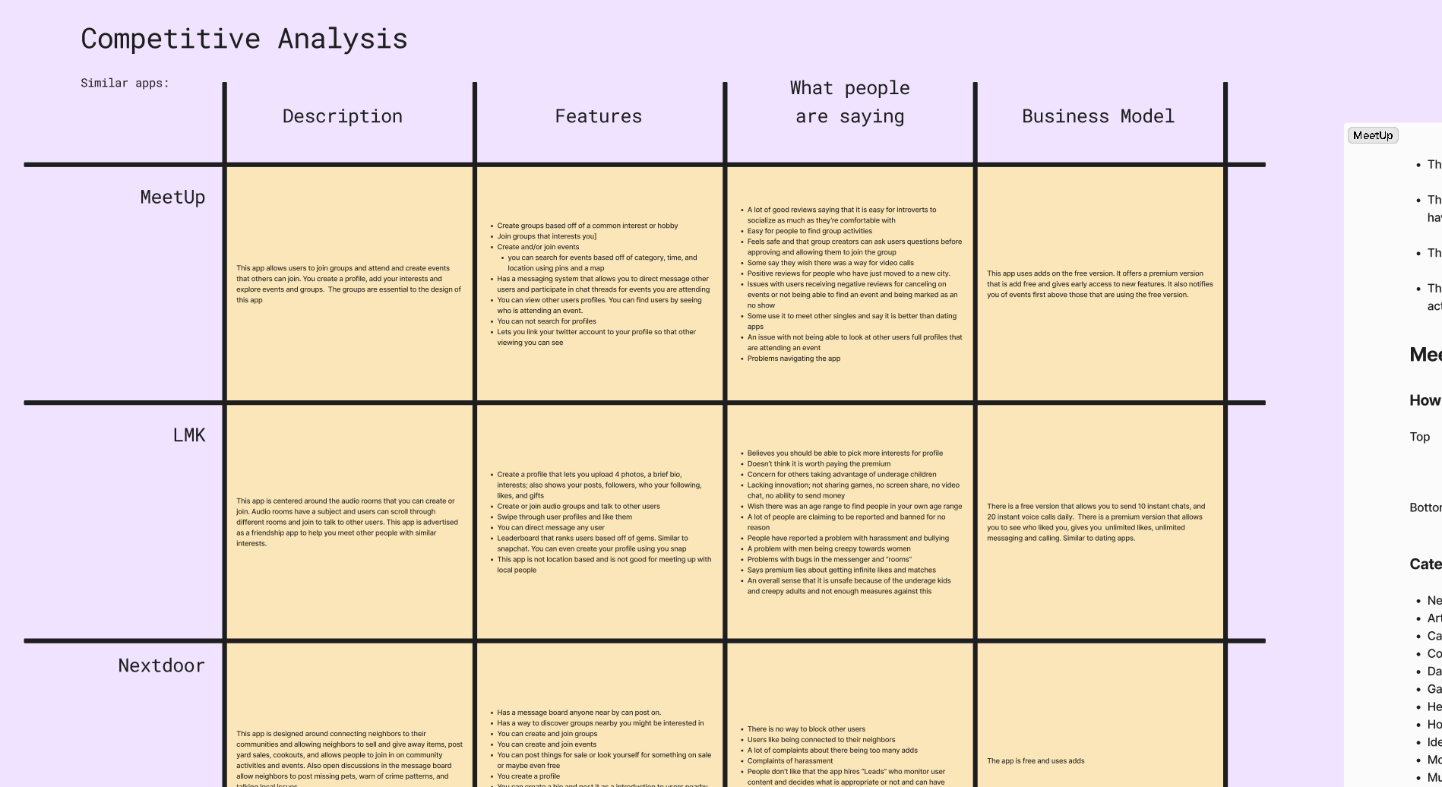
Competitive Analysis
Similar Apps
MeetUp
LMK
Nextdoor
Wink
Hinge
Discover

Slide 5
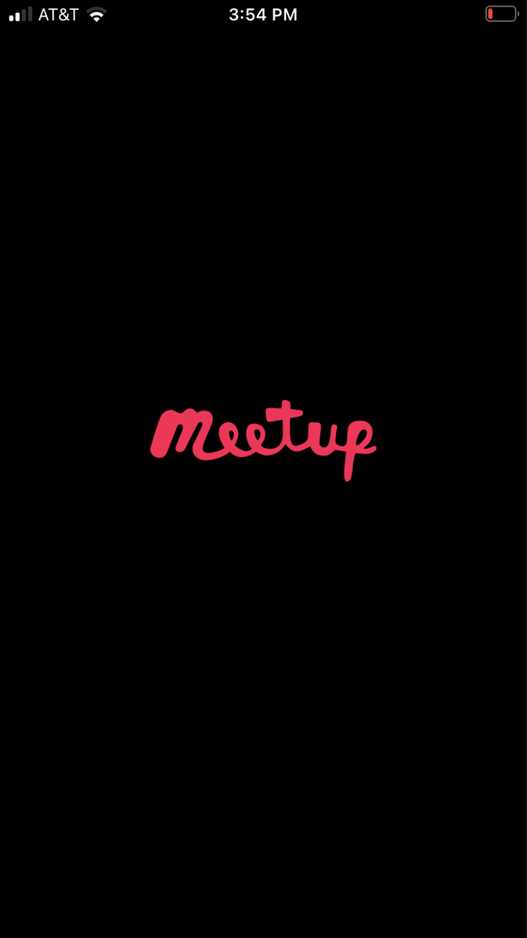
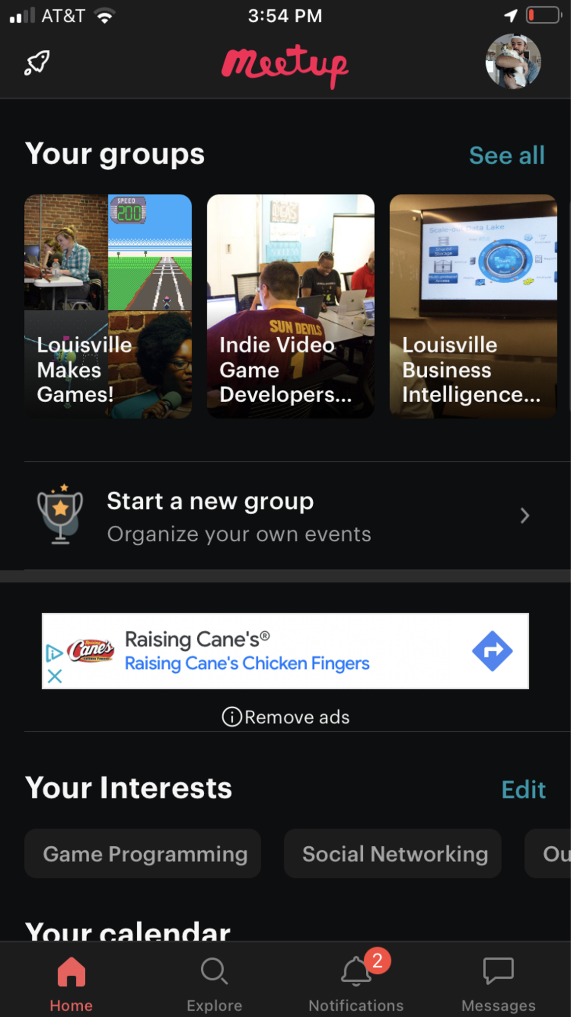
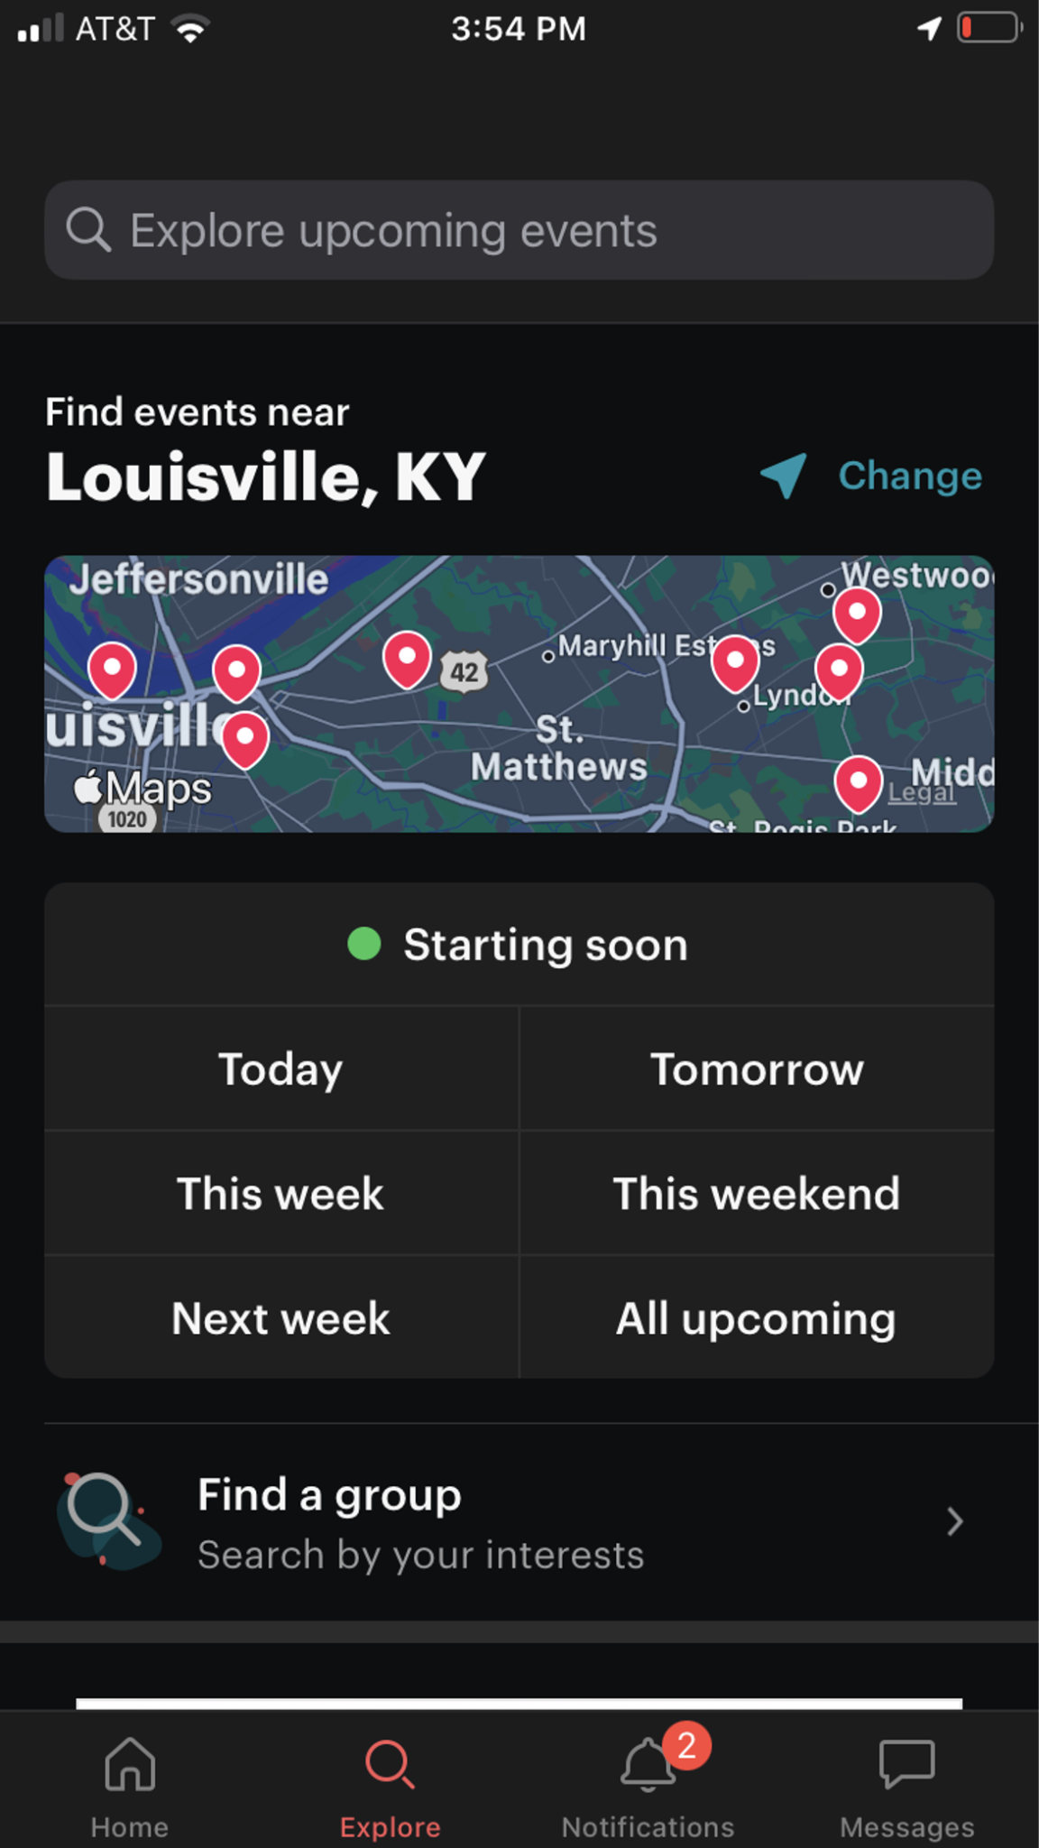
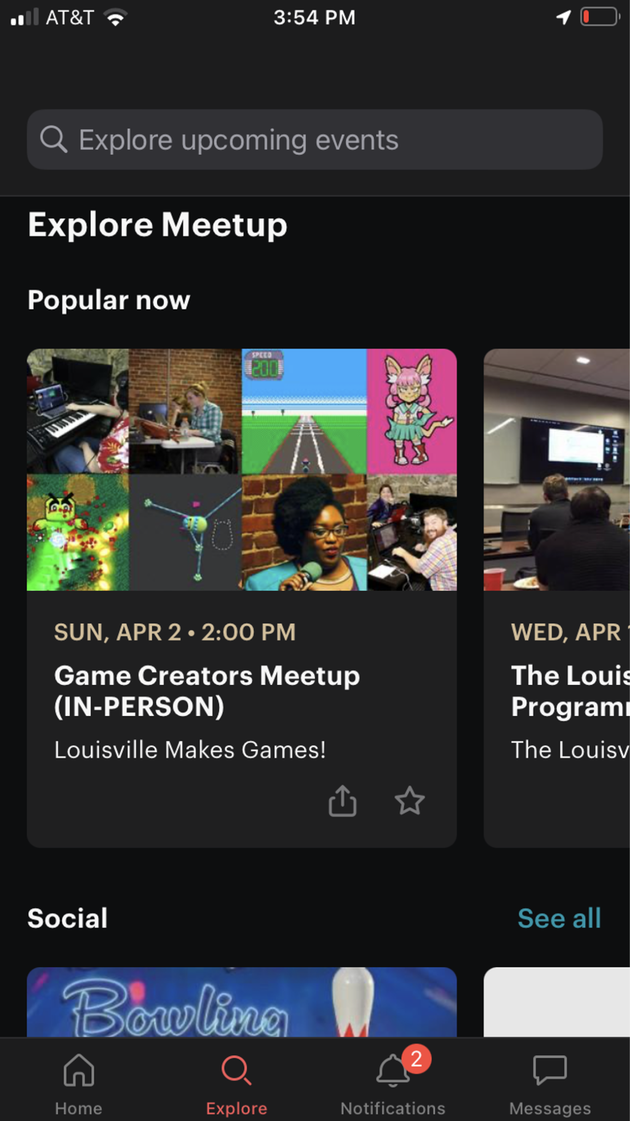
Competitive Analysis | MeetUp
Discover

Slide 6
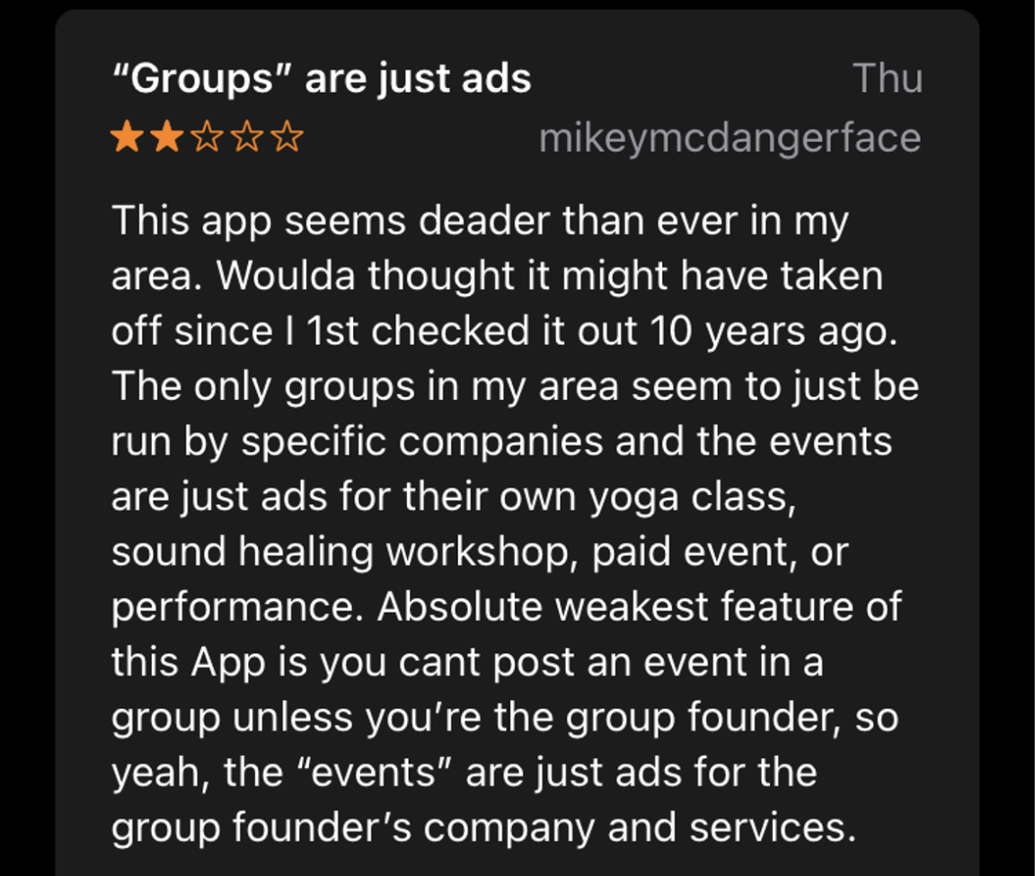
Competitive Analysis | MeetUp
The most similar to our idea
Is based around making and joining groups that host events.
This can be an intimidating aspect to someone who is just trying it out for the first time.
The UI is clustered and hard to navigate.
Uses adds on the free version.
Adds to clutter, annoys user.
Discover

Slide 7
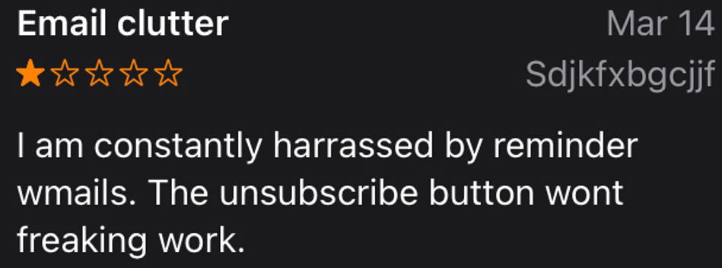
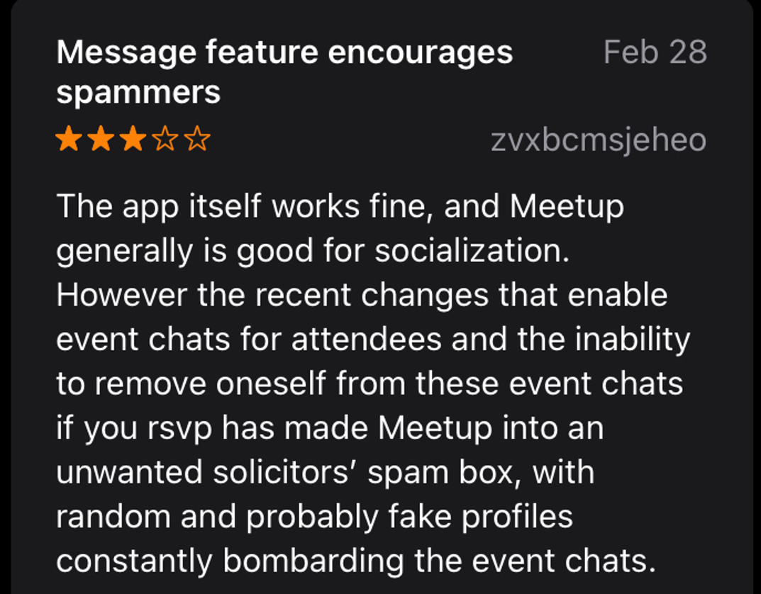
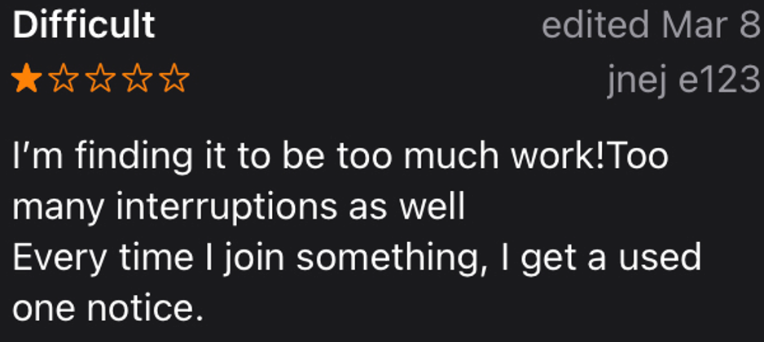
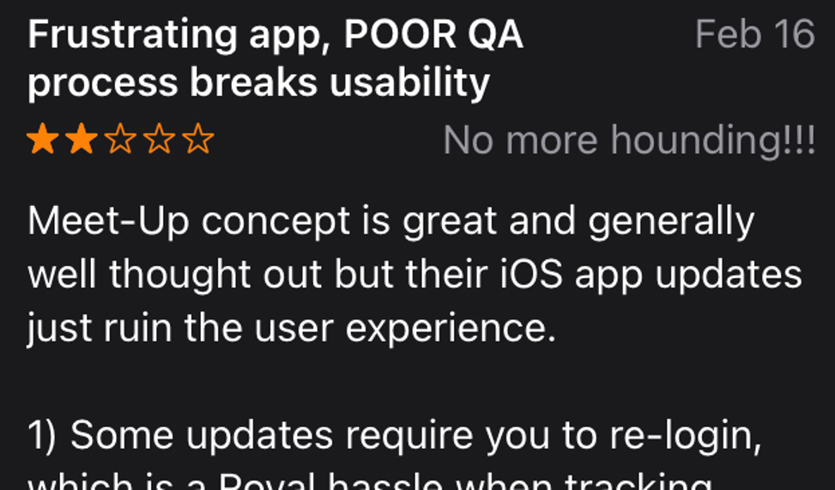
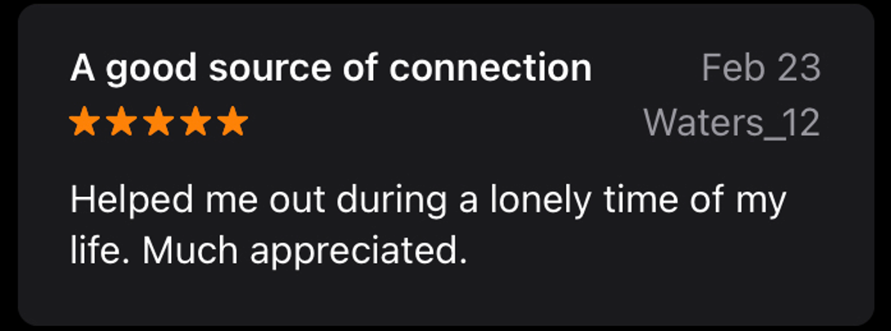
Competitive Analysis | MeetUp
Frustrations from a bombardment of notifications for events they don’t want to join or events and groups they have joined.
It does have its fair share of positive reviews for improving social lives.
A lot of poor reviews that acknowledge that it is a good concept.
Discover

Slide 8
Competitive Analysis | MeetUp
Lessons Learned
Should be more casual so people don’t feel intimidated to try it for the first time.
We want posts to be from real people not groups or companies hosting events.
Posts should not have hero images
You should not have to join or create a group to be able to create or join a event post.
Users should have control over notifications
Discover

Slide 9
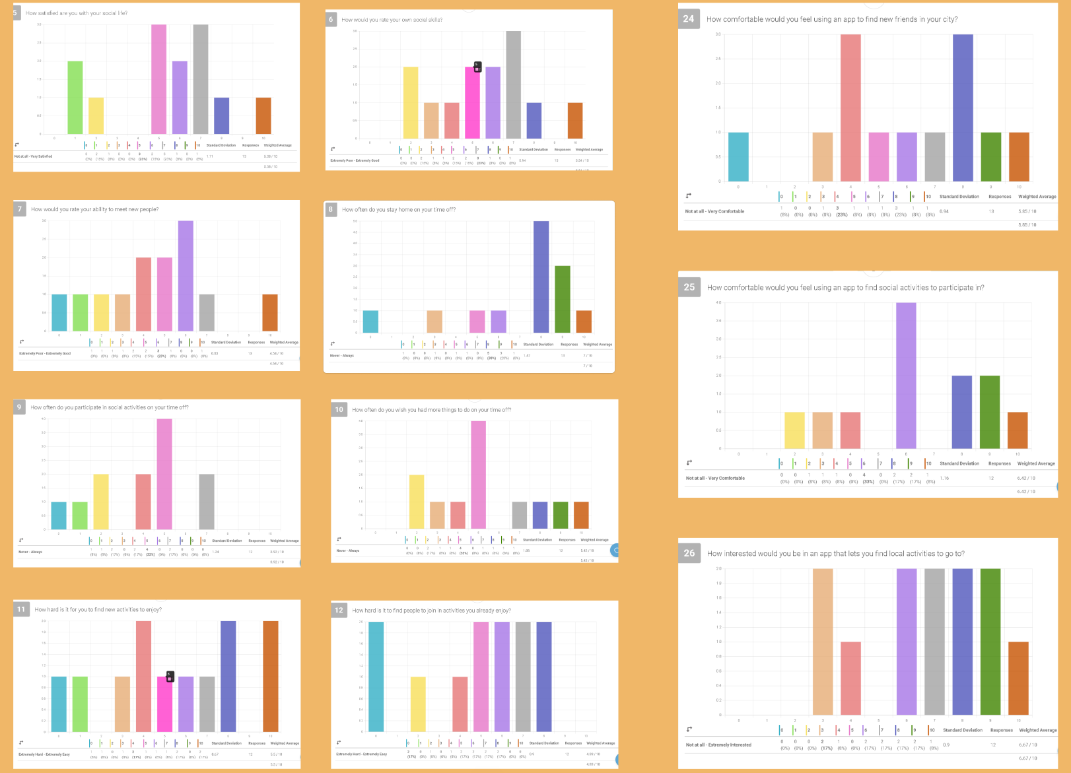
Surveys

Slide 10
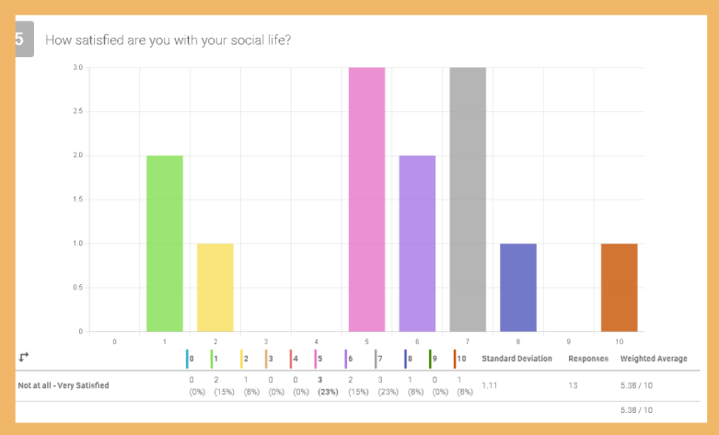
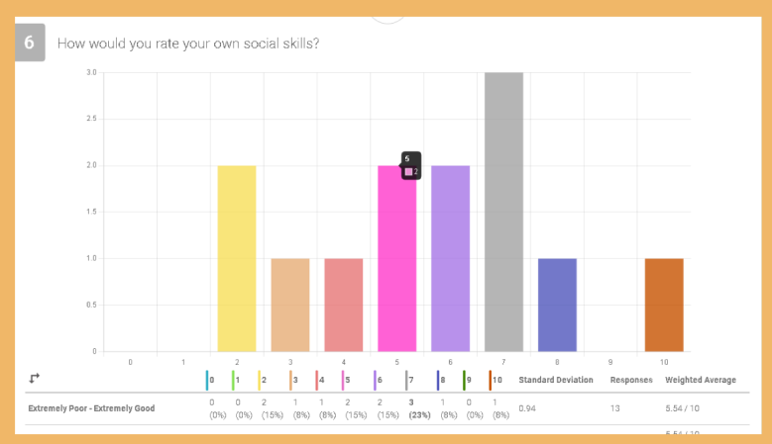
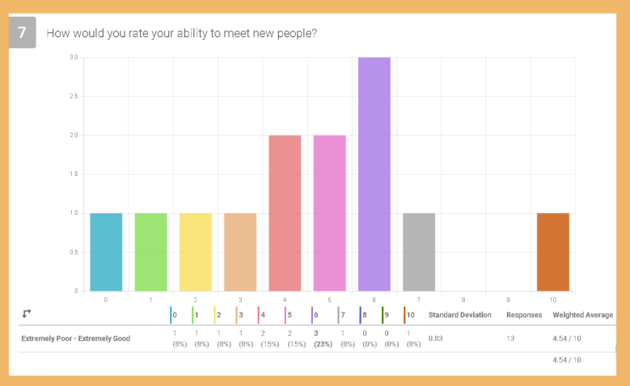
Quantitative
Most people are somewhat satisfied with their social lives.
Those that are not satisfied are very dissatisfied.
No one is very satisfied with their social life.
Everyone feels that they have above average social skills.
Even though people feel that they have social skills, they also mostly feel that they have a lack in ability to meet new people.

Slide 11
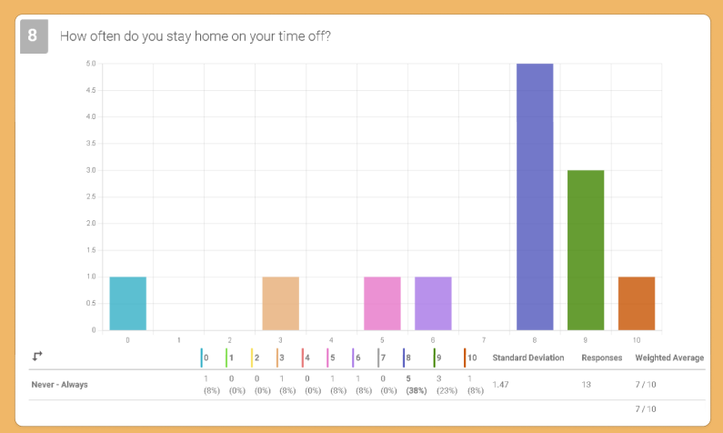
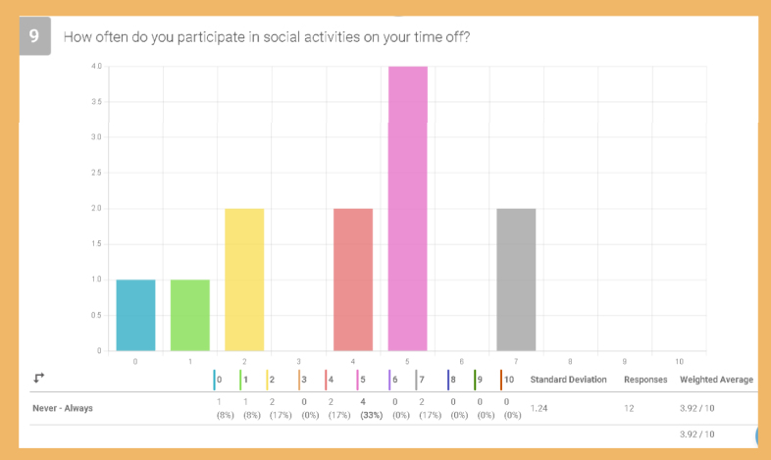
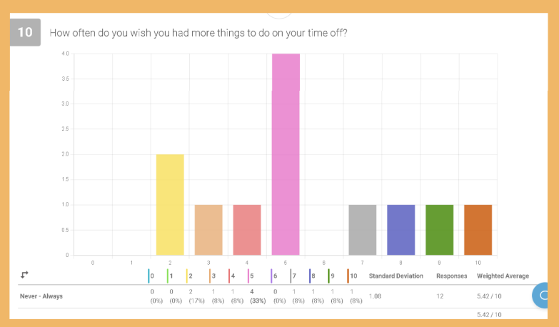
Quantitative
Most people have the habit of staying at home during time off.
Most people trend towards little to medium social activities on their time off.
People show a desire to participate in more activities.
Some showed strong desires to add more social activities to their life-styles.
No one said never.

Slide 12
“I'm excited to meet new people, but I dislike wasting time meeting people that I don't want to see again”
Qualitative
Meeting new people
Most said they feel nervous and anxious.
Trying new things
Most people share an interest in wanting to try new things. Some are also nervous at the same time.
Activities
Most expressed a lack in social activities in their lives. Most wish for more activities to participate in. There was a desire for more structured activities (clubs: so that it is the same people every time)

Slide 13
Constraints
There was a concern for participating in large groups where they did not know anyone. There was a general issue of people not having time, energy, or friends. There was a concern for needing structure when they socialize. There was also the problem of living in rural areas where the drive was a factor in not going out. And of course, money was an issue.
Staying home
People wanted to stay home versus going out because they just wanted to relax. Some said their social activities are mostly online anyway so they didn’t need to leave home to socialize. Stay home to play video games. Others had to stay home because of responsibilities, including chores and looking after their children. Some stayed home because they have no one to hangout with or they live to far away from potential activities
Qualitative

Slide 14
What to look for in new friends
Most said they look for someone with similar interests when making new friends. Very few said that politics where a factor and no one said religion was a factor. There was also a desire for other parents with similar aged children.
Hypothetical move to new city
There is a concern for finding friends and activities in a new city.
Results showed that some would not know how to find friends in a new city, others said they would meet people through work, or through different social media platforms (Bumble BFF, Facebook groups, reddit.
Qualitative

Slide 15
Lessons Learned
Main concerns for people finding new activities and friends are social anxieties in meeting new people.
This is true for the already social and the non-social.
There was a fear in showing up to activities and not having anyone to talk to combined with the anxiety in making new friends.
This could inhibit someone from going to an event.
This exposes a need for people to have the ability to get to know one another before showing up.
This could include an open message board for each event and or a way to privately message between those that plan on attending an event together.
Discover

Slide 16
Lessons Learned
Another issue was needing structure and consistency.
This app was originally intended to be more spontaneous, but there could be a away to create events that are monthly, weekly, daily, etc.
This would allow groups to form without specifically having a group functionality.
These posts would keep an open message board that will be the central place for “members” or those looking to join to keep the impression that it is a group.
For recurring posts, there will need to be away to clear any inactive posts so the boards do not become cluttered. There will have to some sort of validation for the poster to make sure that they are still active in these activities.
Discover

Slide 17
Lessons Learned
Another issue was needing structure and consistency.
This app was originally intended to be more spontaneous, but there could be a away to create events that are monthly, weekly, daily, etc.
This would allow groups to form without specifically having a group functionality.
These posts would keep an open message board that will be the central place for “members” or those looking to join to keep the impression that it is a group.
For recurring posts, there will need to be away to clear any inactive posts so the boards do not become cluttered. There will have to some sort of validation for the poster to make sure that they are still active in these activities.
Discover

